Slide 1
Learning Through Time in the Thalamocortical Loops
Randall C. O’Reilly
University of Colorado Boulder
eCortex, Inc

Slide 2
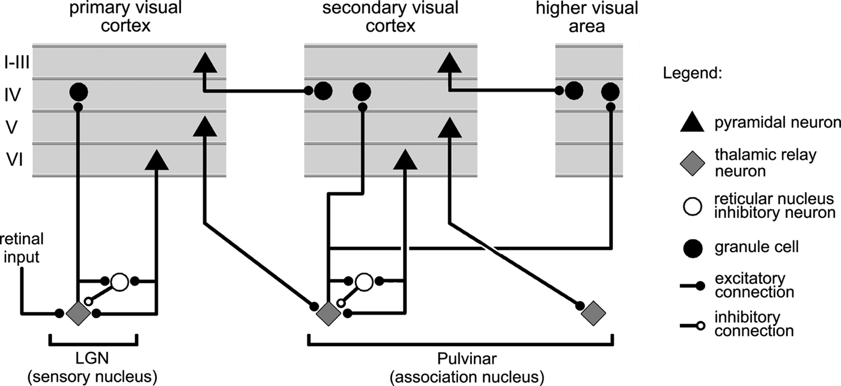
What do Thalamocortical Loops Do? (Sherman & Guillery, 2006)
Deep Layers drive thalamus, have strong top-down feedback effects.

Slide 3
Thalamocortical Mysteries
Why does higher-order thalamus have a few strong driver inputs, and far more weaker ones?
Why are these drivers non-plastic? How can cortex learn if thalamus does not?
What is function of the alpha rhythm (10Hz), which predominates in deep layers and thalamus?

Slide 4
Three Functions in One Circuit
Top-down / bottom-up attentional dynamics: deep layers particularly important for top-down.
Predictive learning based on t-1 context representations (SRN), also in deep layers.
Thalamic relay cells (TRC) are substrate for local auto-encoder learning.

Slide 5
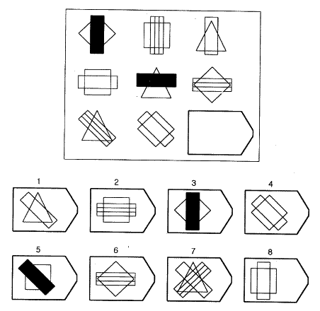
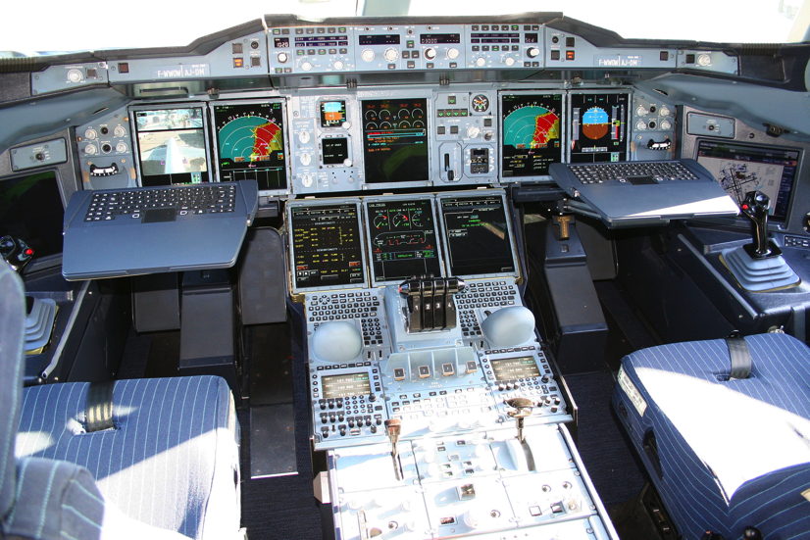
Cognitively: What is Vision For?
Vision is active, goal-driven, requires iterative, flexible parsing of complex visual scenes

Slide 6
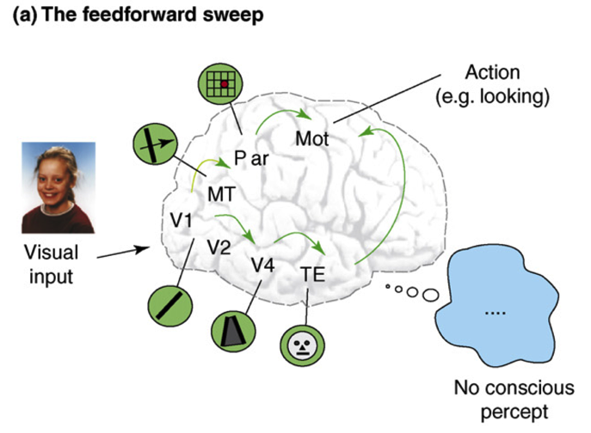
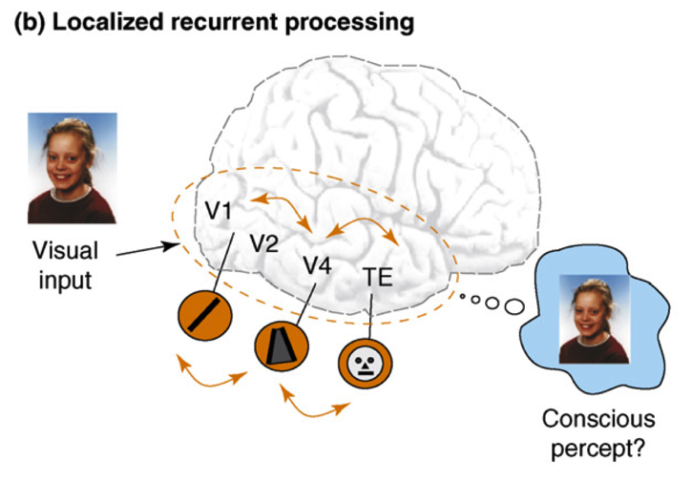
Recurrent Processing -> Consciousness (Lamme, 2006)
Consciousness is Unitary
Recurrence coordinates all areas on one thing (emerges via popular vote)
Consciousness is Functional
Helps organize, prioritize behavior – “focusing” key for difficult problems
Consciousness Flows
Temporal dynamics and information processing (multi-step cognition)

Slide 7
Attention and Consciousness
Recurrent dynamics / consciousness supports goal-driven top-down interaction with bottom-up visual processing: How to capture in a model?
Superficial cortical layers = basic Hopfield / Boltzmann style recurrent network
Deep cortical layers & thalamus = specialized attentional network, key for robust, flexible attn

Slide 8
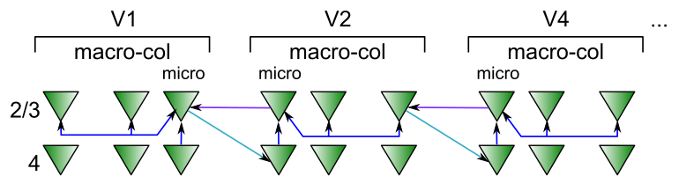
Superficial Attractor / Constraint Satisfaction Network
Computationally captured by Hopfield / (Deterministic) Boltzmann Machine models..
Except that cortical pyramidal neurons are only excitatory – need inhibitory interneurons

Slide 9
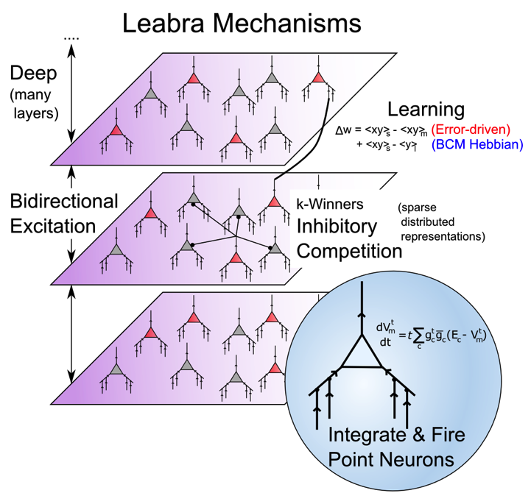
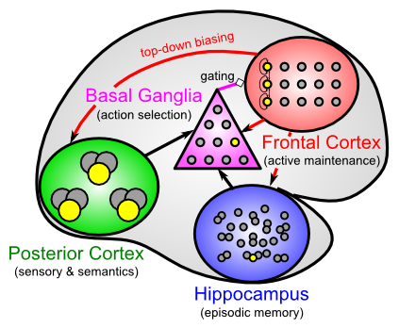
Leabra Biologically-based Cognitive Architecture
Same framework accounts for wide range of cognitive neuroscience phenomena: perception, attention, motor control and action selection, learning & memory, language, executive function – all built out of the same neurons.
http://ccnbook.colorado.edu

Slide 10
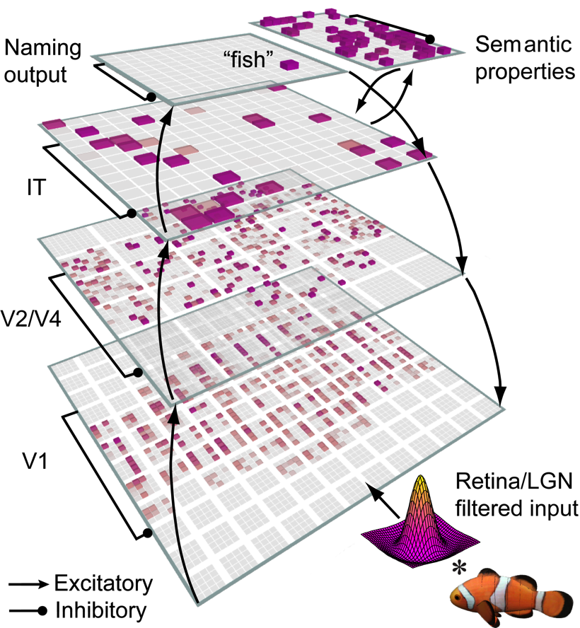
Bidirectional Object Recognition (e.g., O’Reilly et al., 2013)
100-way invariant object recognition

Slide 11
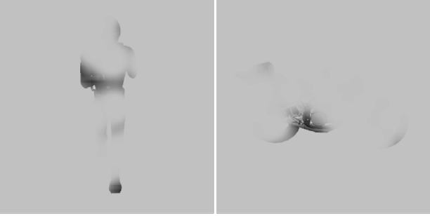

Benefit of Bidirectionality: Robust to Partial Occlusion

Slide 12
Human Data (Wyatte et al, 2012)

Slide 13
But…
Attractor nets don’t pull out individual elements from complex scenes, or rapidly shift (instead, get “stuck”)

Slide 14
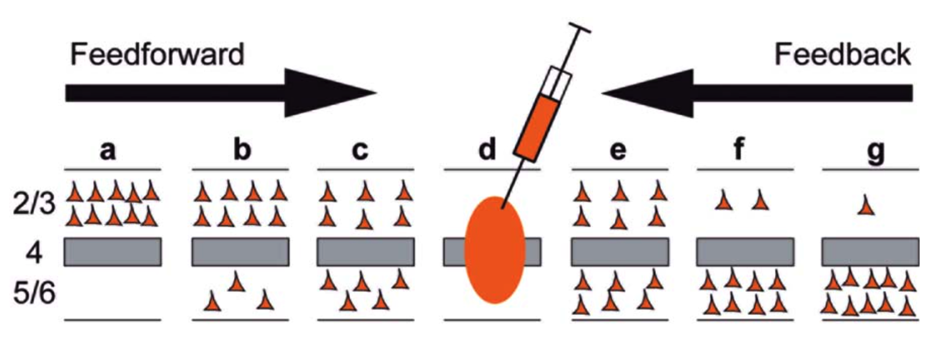
Deep Dominates Feedback
Markov et al, 2014
Feedback projections, especially those further up the hierarchy, are predominantly from deep layers – deep is particularly important for top-down attentional processing..

Slide 15
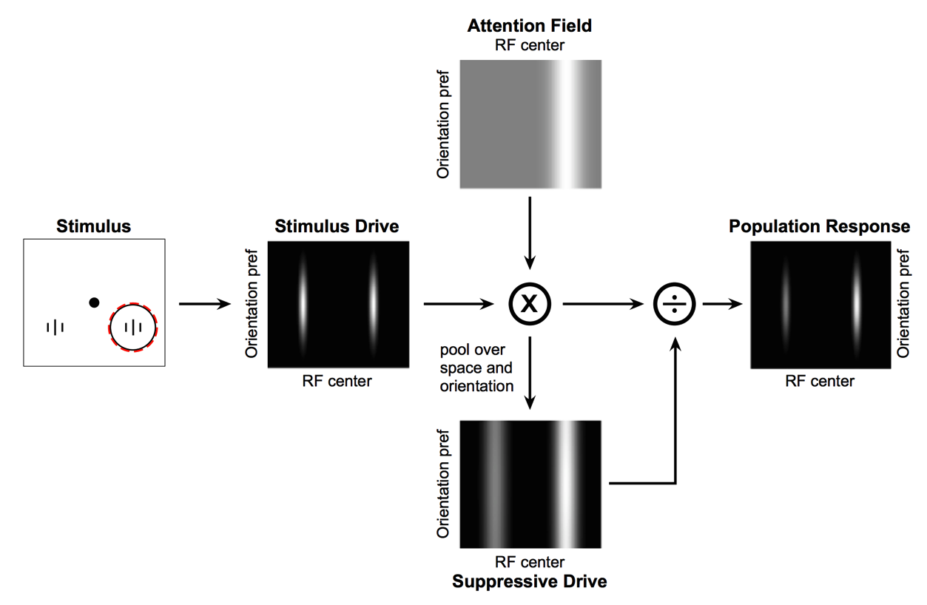
Deep Attentional Dynamics (Reynolds & Heeger, 2009; Grossberg, 1999)
Top-down deep layer
Attentional drive
Inputs to Layer 4
Layer 6 gain control
(Olsen, Bortone et al)

Slide 16
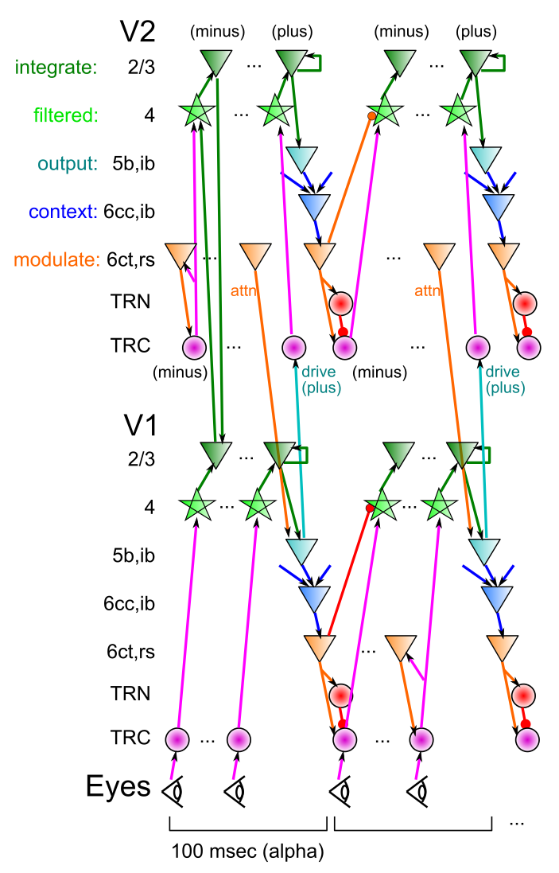
DeepLeabra
Deep neocortical layers drive multiplicative attentional modulation, through direct and thalamically mediated connections.
Alpha cycle (100msec) provides frame rate for updating of attentional mask, determined by 5ib bursting
EM-like dynamics where superficial network settles within fixed attentional mask, then attn mask is updated..
5ib also drives feedforward TRC prjn: plus phase clamp of TRC-based autoencoder (local learning signals)
6cc context provides SRN-like temporal context information for predictive learning

Slide 17
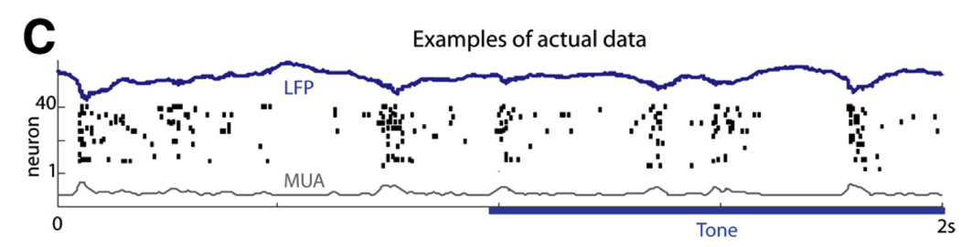
TI: Key Biological Data
Alpha freq dominant in deep layers (e.g., Buffalo et al, 2011).
Sustained auditory tones discretized into alpha “packets” (Luczak et al, 2013)
Many indications of discretization in perception (Van Rullen & Koch, 2003)
Predictive coding during saccades
Deep5b alpha bursting to a continuous auditory tone (Luczak et al, 2013):

Slide 18
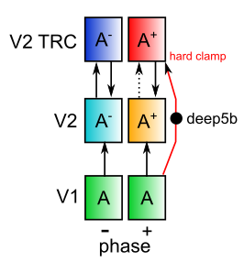
Nested Thalamic Auto-Encoders (Deep5aed: Deep5b Auto Error Driven)
Really is a standard auto-encoder!

Slide 19
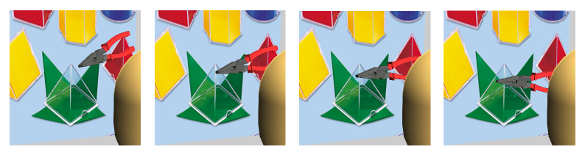
Auto-Encoder over Time: Predictive Learning
Predictive learning creates nearly infinite supply of challenging learning problems: can learn a lot about physics and visual structure
Widely exploited idea: Helmholtz, Elman, Hawkins…
Requires encoding of prior context for future prediction (SRN)

Slide 20
Thalamocortical Mysteries
Why does higher-order thalamus have a few strong driver inputs, and far more weaker ones?
Why are these drivers non-plastic? How can cortex learn if thalamus does not?
TRC as auto-encoder: FF drivers provide “plus phase” training signal, as fixed xform of input layer
What is function of the alpha rhythm (10Hz), which predominates in deep layers and thalamus?
EM outer loop, defines minus-plus learning frame

Slide 21
Current Results
Deep attentional dynamics can pick out figure object against background – motion and binocular depth cues provide figure signal.
TRC auto-encoder on V2, V3 produces some learning benefits.

Slide 22
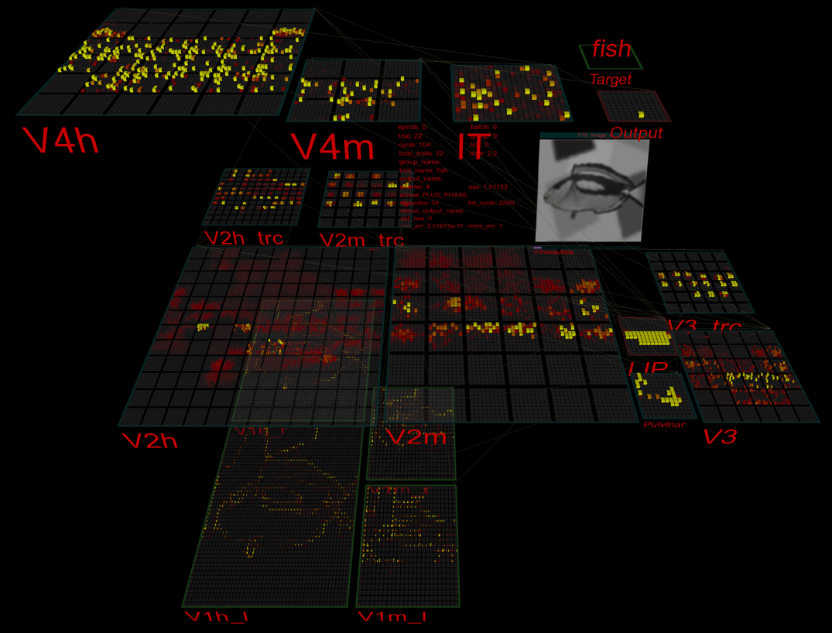
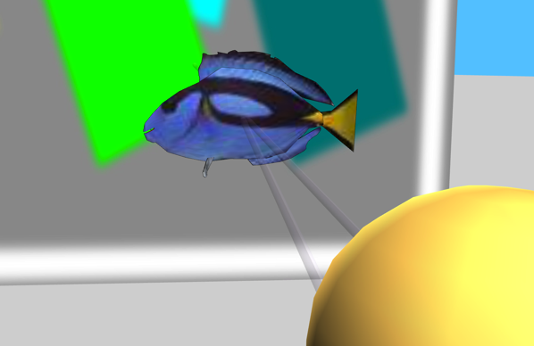
3D Virtual Reality Learning

Slide 23
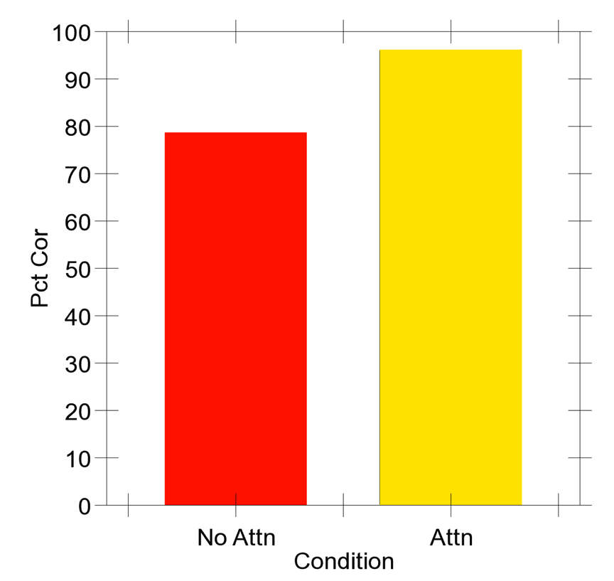
Very Preliminary Results..
50 objects against complex backgrounds..

Slide 24
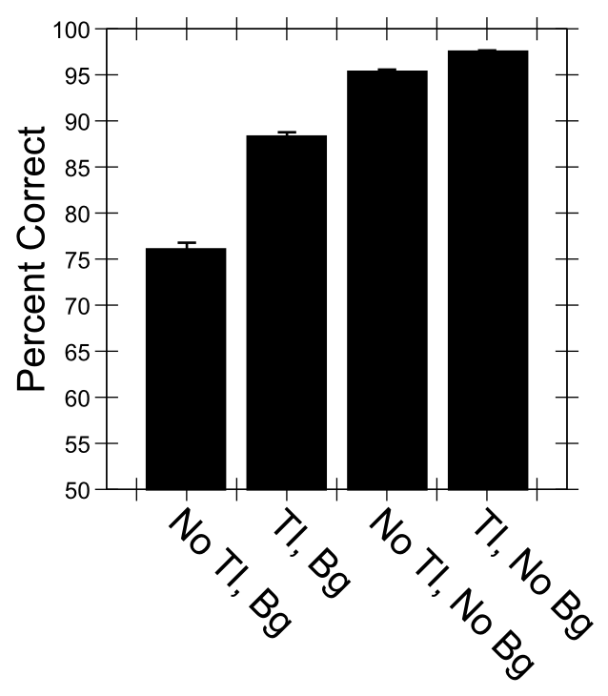
Predictive Auto-Encoding Supports Figure-Ground Segregation
Bg = backgrounds present
No Bg = Not
Differential advantage for backgrounds present case
of TI = Temporal Integration = predictive learning

Slide 25
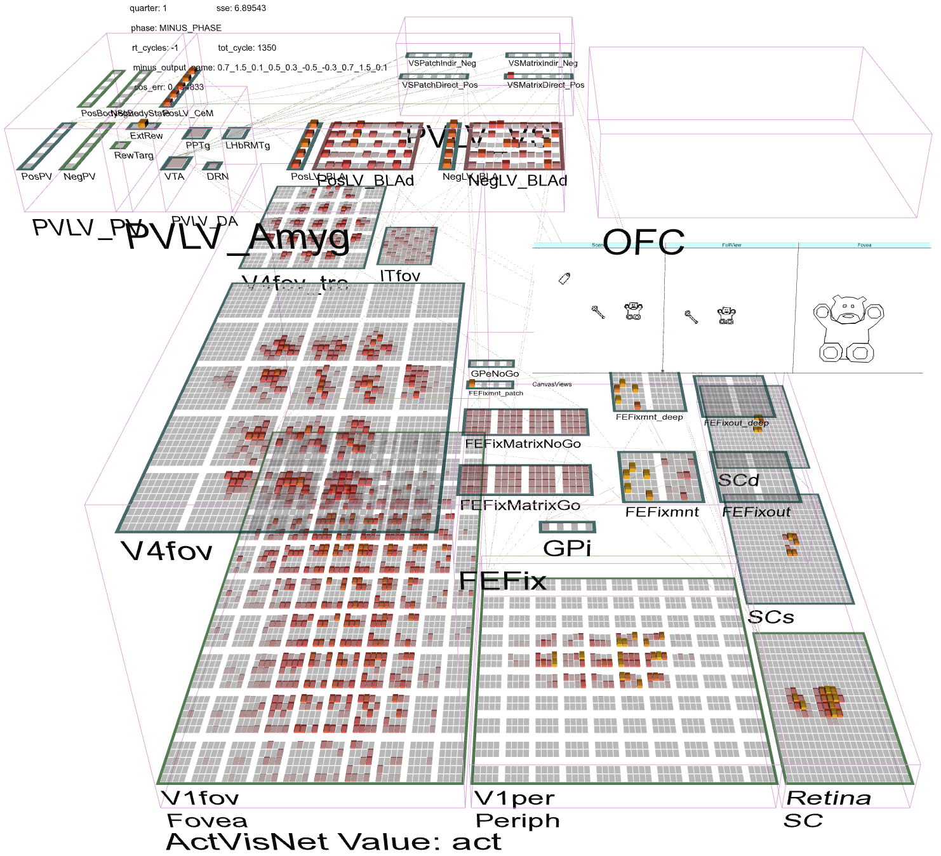
Full Brain Interactions: OFC, FEF..

Slide 26
Problems with Recurrent Connectivity
Computationally much slower than feedforward
~100 cycles per input image, ~4x connections (2x directions, superficial and deep)
Not applicable to ImageNet scale at this point
Could really use fast specialized hardware! (“if I only had a brain…”)
But algorithms are under rapid development..
Much more complex dynamics: learning problem is much more difficult

Slide 27
Summary: Two Networks in One
Recurrent dynamics / consciousness supports goal-driven top-down interaction with bottom-up:
Superficial cortical layers:
Hopfield / Boltzmann constraint satisfaction
Deep cortical layers & thalamus:
Top-down / bottom-up attentional dynamics: deep layers particularly important for top-down.
Predictive learning based on t-1 context representations (SRN), also in deep layers.
Thalamic relay cells (TRC) are substrate for local auto-encoder learning.

Slide 28
TDLC Connections: Tim and Dave (ONR funding)
Tim Curran: EEG recording of top-down / bottom-up dynamics for familiar vs. novel objects
David Sheinberg: Monkey electrophysiology on same experiments as humans

Slide 29

Training Paradigm

Slide 30
Thanks To
CCN Lab
Tom Hazy
Seth Herd
Tren Huang
Dave Jilk (eCortex)
Nick Ketz
Trent Kriete
Kai Krueger
Scott Mackie
Brian Mingus
Jessica Mollick
Wolfgang Pauli
John Rohrlich
Sergio Verduzco-Flores
Dean Wyatte
Funding
ONR – Hawkins
ONR – McKenna & Bello
IARPA – ICArUS
ARL RCTA
NIMH P50-MH079485

Slide 31
Extras

Slide 32
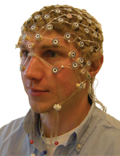
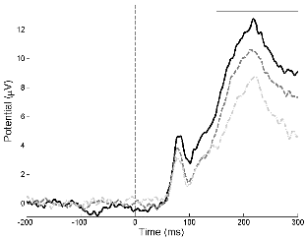
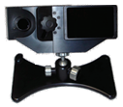
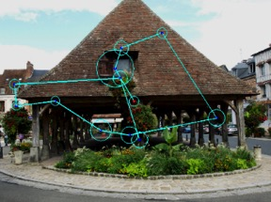
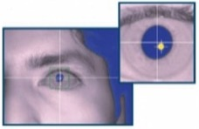
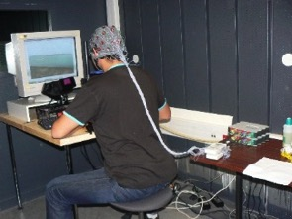
Curran Lab
Wyatte Thesis Follow-up Experiment
Experiment 1 Piloting
EEG
Eye Tracking
Co-recording of EEG
and eye tracking

Slide 33
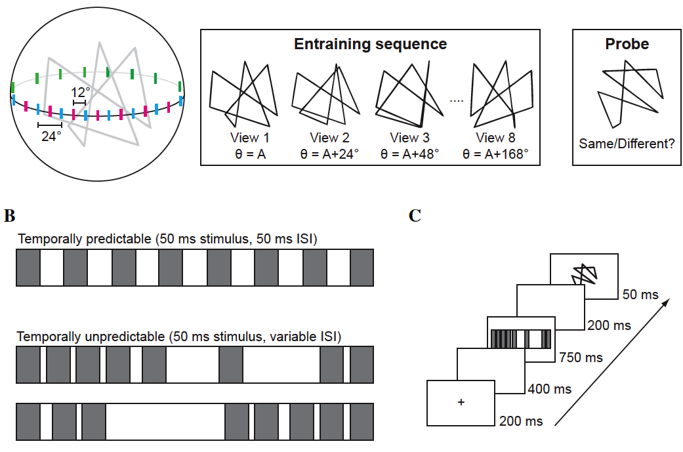


http://psych.colorado.edu/~tclab/experiment.html
Notes:
You don’t need both slides 4 and 5. Pick your favorite.
Note that unlike the next experiment where matching is done across exemplars and based on species membership, same/different judgments are made here with regard to whether or not it’s the exact same exemplar.

Slide 34
Experiment 1 Piloting
Goal
Train subjects to learn novel object categories as a way to manipulate top-down knowledge.
Based on expertise training experiments with birds and cars (Tanaka, Curran, Sheinberg, 2005; Scott, Tanaka, Sheinberg, Curran, 2006; 2008)
Using novel “Creatures” as stimuli
Novel to both human and macaque subjects
Possible to generate many exemplars of each species.
Pilot Question: Similar accuracy levels as birds and cars?
Stage 2 piloting with a more a more macaque-friendly training task.
Notes:
Could maybe reverse the order of the two experiments, to include more intro to creature stimuli.

Slide 35
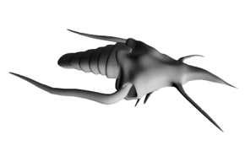
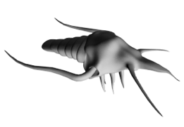
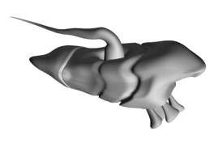
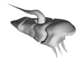
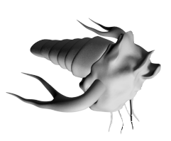
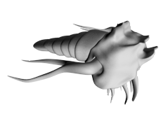
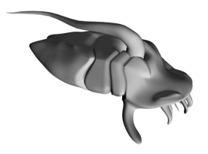
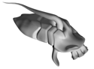
Creature Families: Sheinbugs
Arns
Stots
Species A
Species C
Exemplar 1
Exemplar 2
Exemplar 1
Exemplar 2
Species B
Species D
Exemplar 1
Exemplar 2
Exemplar 1
Exemplar 2
There are 2 stimulus families.
Each family contains 10 species.
Each species contains 12 exemplars.
Notes:
Think of these as being analogous to different families of birds like owls vs. wading birds. Within each family there are different species like barn owls vs. snowy owls, and within each species there are different exemplars of each.

Slide 36
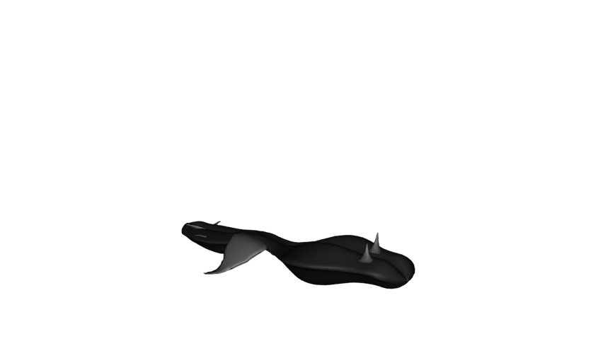
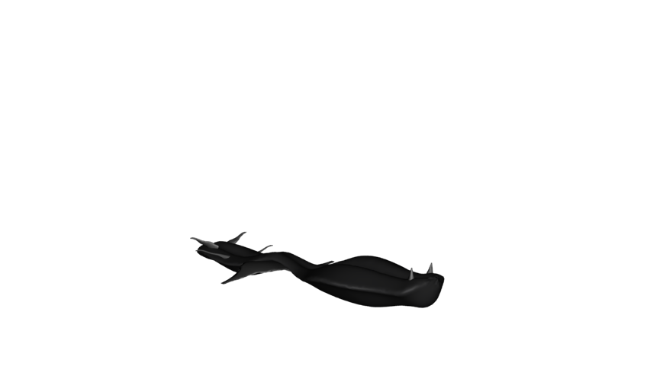
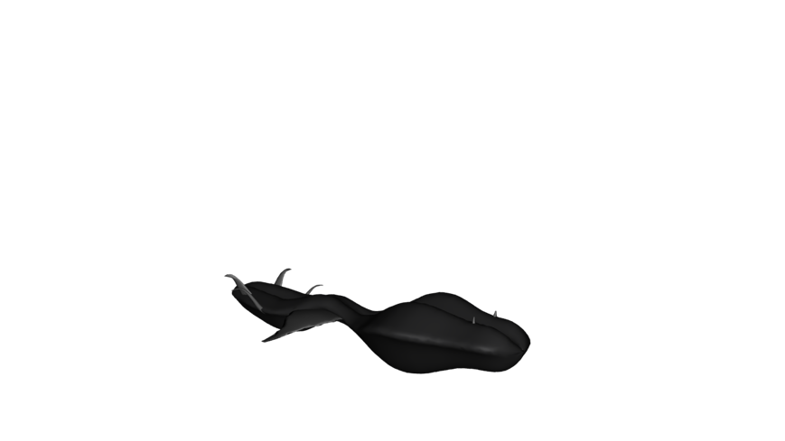
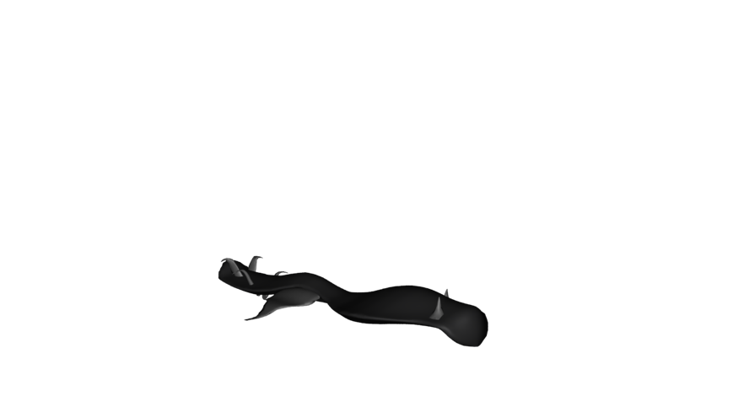
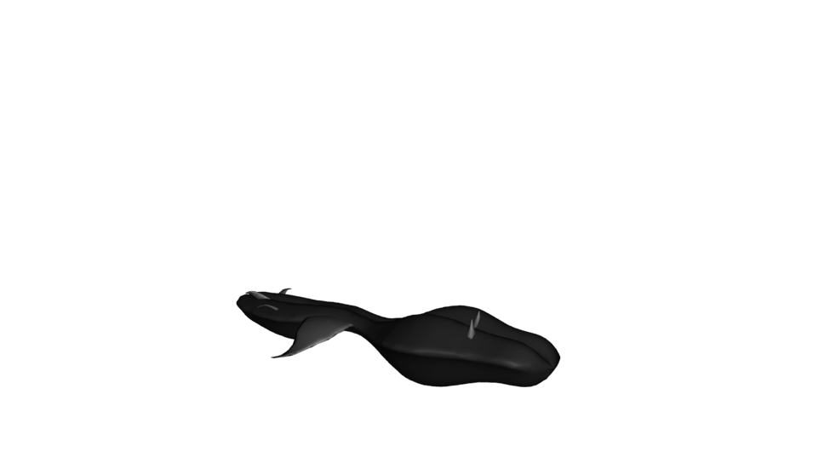
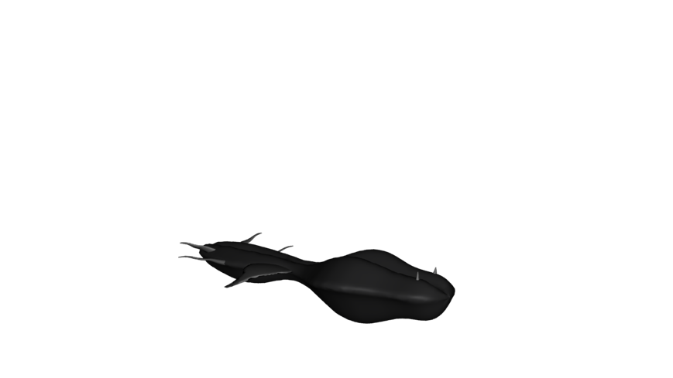
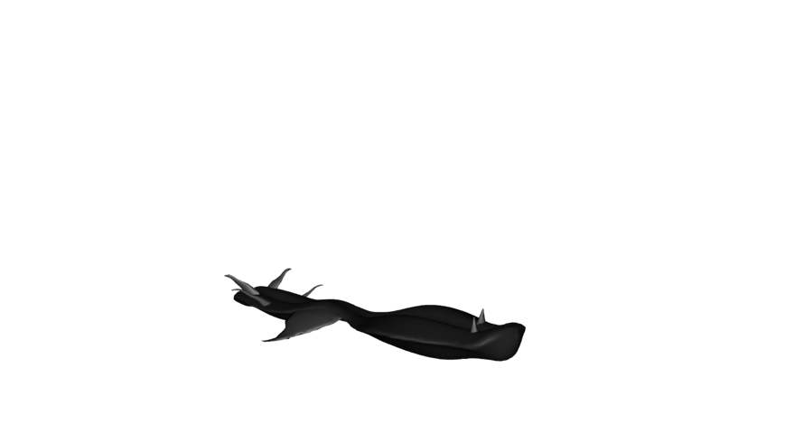
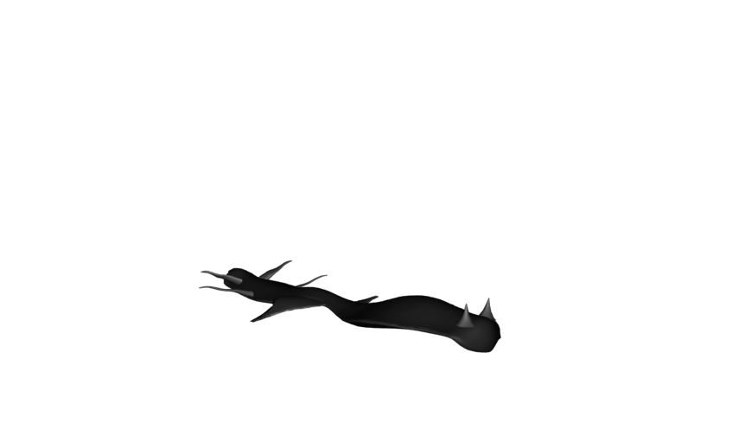
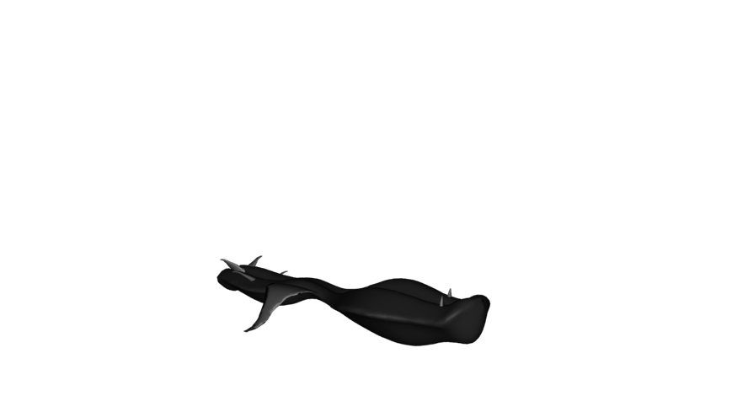
New Objects: Basic Level Learning
All Same Family

Slide 37
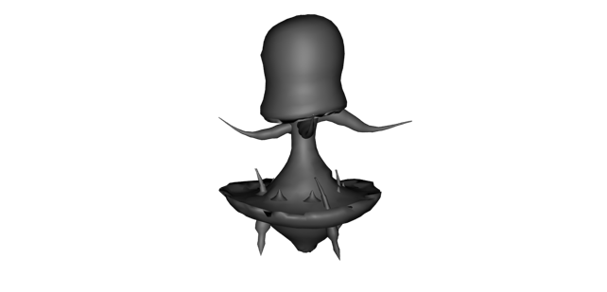
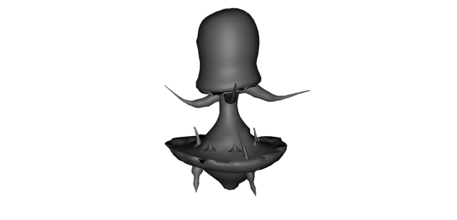
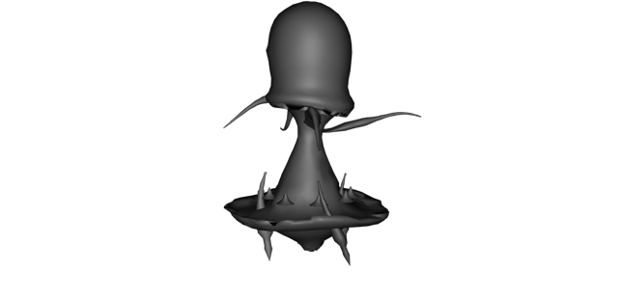
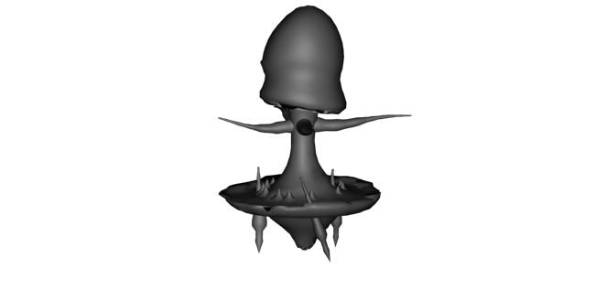
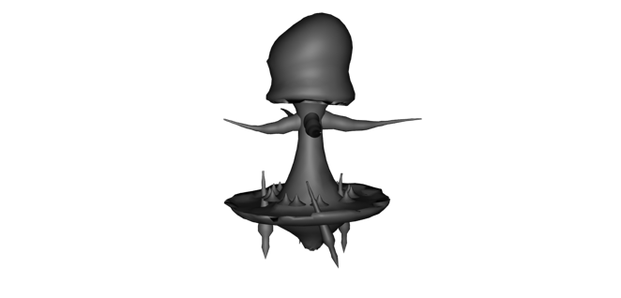




Subfamily Learning
Sub-Family 1
Sub-Family 2
Sub-Family 3

Slide 38





Method
Species C
Species D
Species C
Pre-test
Species A
Post-test
Training
Day 1 Day 2 Day 3 Day 4 Day 5 Day 6 Day 7 Day 8
Two-weeks

Slide 39

Tasks
Pre- and Post-Test Species Matching
Compare Trained Family (top-down effects present) vs.
Untrained Family (top-down effects absent)
Space Invader Training Task
Notes:
Matching tests include both train and untrained exemplars, to test for generalization.
The Family labeling condition is a control condition that does not lead to very good learning, and little/no improvement in matching task performance. It’s a way to control for the effect of exposure.

Slide 40

Preliminary Training Data

Slide 41

Scaling Performance
Important to retain lower resolution while adding higher resolution inputs

Slide 42

Where do the Targets Come From?

Slide 43
The Bootstrap Solution
How do the high-level “outputs” get active?
From a sensory modality (e.g., auditory input)
Infinite regress: need high-level training of that!
Solution: need to bootstrap our way up to multi-modal mutual-training systems (c.f., Becker, de Sa)
Now we just need a way for sensory modalities to train themselves… and Hebbian learning isn’t up to the task.

Slide 44


Slide 45

Nested Thalamic Auto-Encoders (Deep5aed: Deep5b Auto Error Driven)
Each layer learns by auto-encoding the layer below (c.f., restricted Boltzmann machines)
Plus phase target: Deep layer 5b neocortical neurons (intrinsic bursting, 10Hz alpha rhythm): drivers of thalamic relay cell (TRC) firing at next feedforward layer (Sherman & Guillery)
Minus phase: weaker but much more numerous layer 6 -> TRC

Slide 46
Nested Thalamic Auto-Encoders (Deep5aed: Deep5b Auto Error Driven)
Advantages:
Automatic, internal – / + phases
deep5b bursting = amplification of error signals – each layer has own local error
Encoding is done on reduced, transformed version of prior layer -> greater abstraction
Full bidirectional constraint satisfaction across network contributes to minus phase
and plus phase: supports both local and distal learning

Slide 47
Nested Thalamic Auto-Encoders (Deep5aed: Deep5b Auto Error Driven)
Advantages:
Each layer is more strongly constrained – should improve generalization and overall robustness – e.g., object recognition operates on “2.5d sketch” of visual world, not just on pixels or gabor jets
Fixes “adversarial image” problem?

Slide 48

LeabraTI: Learning Through Time

Slide 49


Test Application: Learning Early Visual Structure

